Slide 1
Sense
Crowdsourcing of Sensors

Slide 2

Crowdsourcing
Crowdsourcing is modern business term which is defined as a process of obtaining data in the form of services, ideas or content from the online community
Sensors have become part of today’s technology
Sensors + Cloud
Analysis of various patterns
Effective use of data

Slide 3
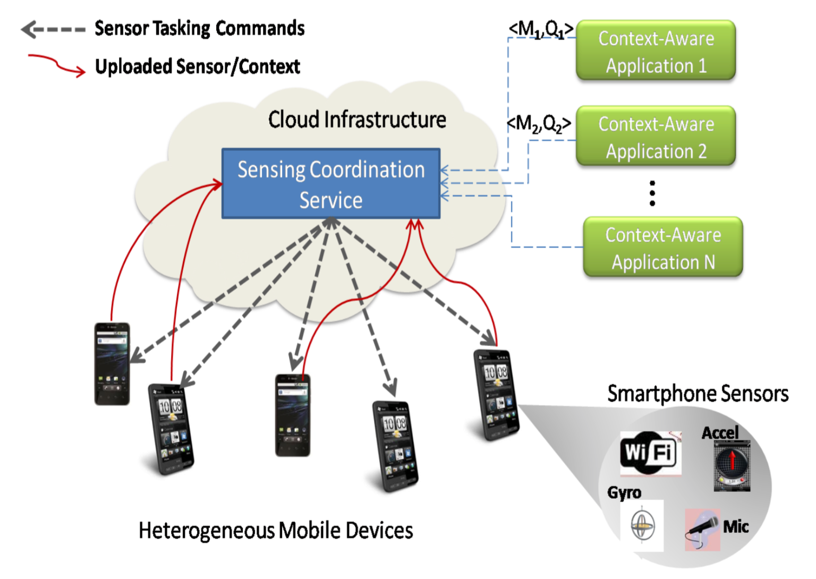
Crowdsourcing
Overview of the System

Slide 4
Smart Phone Sensors
Accelerometer Sensor
Gravity Sensor
Gyroscope Sensor
Light Sensors
Magnetic Field Sensor
Proximity Sensor
Pressure Sensor

Slide 5
Practical Applications
Healthcare
Environmental scenarios (Hazard notification)
Smart City
Smart Traffic Solutions
Emergency Vehicle Alert

Slide 6
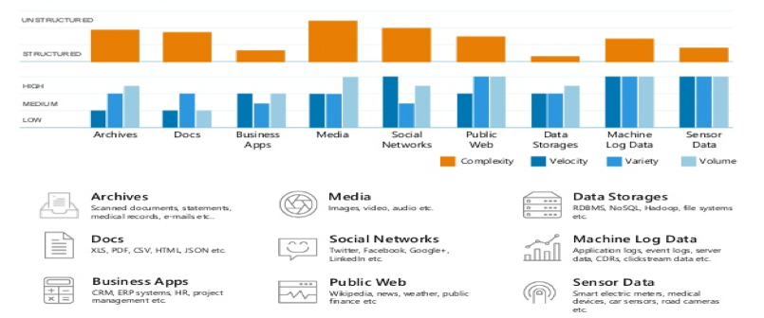
Big Data Challenges

Slide 7
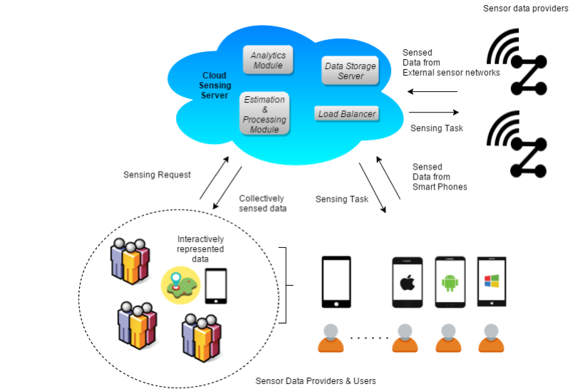
Cloud Sensing
Infrastructure of the System

Slide 8
Key Components
Mobile Sensor Cloud sources
Data acquisition and pre-processing module
Cloud layer
Interactive mobile client
Web Services Layer

Slide 9
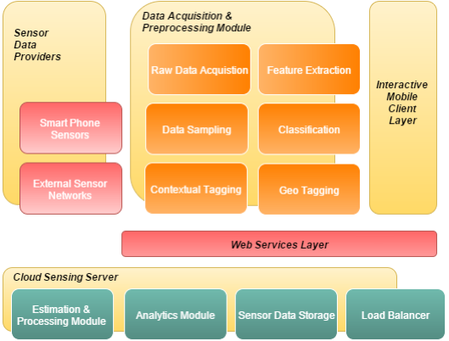
Architecture

Slide 10
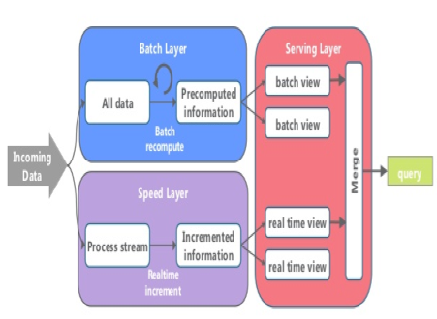
Real-time data processing
Challenges
Volume, variety and velocity
Proper data collection streams
Parallel Processing
Strong Network Connection
Complex event processing engine

Slide 11
Sense does…
On demand registering and unregistering of sensors
On demand upload of Sensor data to cloud
Dashboard displaying sensor values
Sensor location mapping in google map
Parse cloud for sensor data storage
Material Design

Slide 12
Material Design
Modern UI for the sensing application
Use of Card Layout
Custom designed layouts like Glass, Custom Button for different ui components
Created GIF images animations using Movie
Use of fragments
Custom Icons

Slide 13
Screens

Slide 14
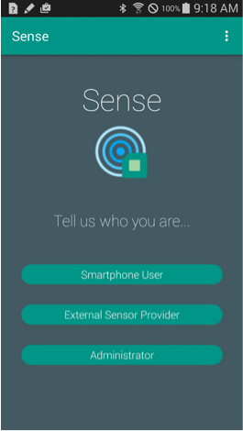
Main Screen
Has three types of user

Slide 15
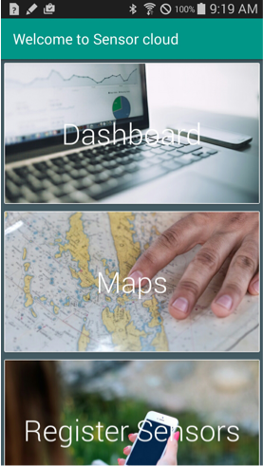
Home Screen
Shows list of available sensors and their current values
Map shows locations of Sensors from cloud data
You can customize the sensors data to upload
Upload data of registered sensors in cloud

Slide 16
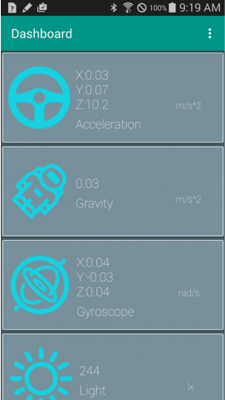
Dashboard
List of sensors in phone with live values
Custom Card Layout

Slide 17
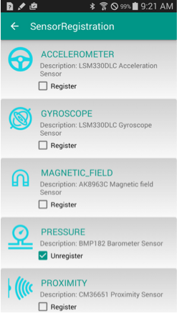
Register Sensors
List of available Sensors in phone
Facility to register and unregister sensor at anytime
Glass Layout for list UI

Slide 18
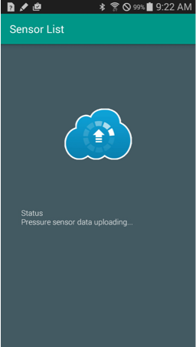
Upload Data
Upload the sensor data after every 30 seconds
Async tasks
Use of only registered sensors
Custom GifView

Slide 19

Threats in Crowdsourcing
Disclosure of user identity
Disclosure of user location and activity
Lack of user privacy awareness
Vulnerability of mobile devices
Relying on data that is incorrect
Retaliation of reporting sensitive information

Slide 20
Future enhancements
Sensor Provisioning
Export/Import data using ReST-API calls
Air quality and radiation exposure monitoring
Disaster Management and quick evacuation plans
Introduce Incentive mechanism
Sense iOS App

Slide 21
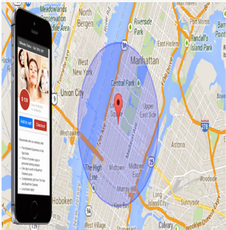
Future enhancements
Geofencing with google maps for Push Notification
Geofencing allows you to establish a virtual fence around a predefined geographic area
This can be used to alert users registered with the system
Environmental hazards push notifications

Slide 22
Demo

Slide 23
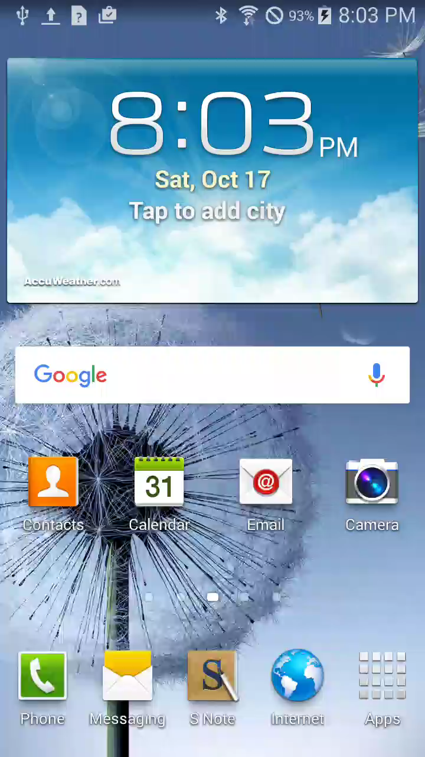

Slide 24
Thank you
Isha Patel
Priya Singara Velu
Saraswathi Thanu
Shraddha Kannav

